Slide 1


Slide 2
Course Handout
 | Data Structures and Algorithms

Slide 3
Course Handout
CH1 | CH1.1 = Algorithmic problem CH1.2 = Analytical model to analyze algorithm CH1.3 = Pseudocode & Algorithm CH1.4 = Asymptotic Complexity

Slide 4
IMP Note to Students
It is important to know that just login to the session does not guarantee the attendance.
Once you join the session, continue till the end to consider you as present in the class.
IMPORTANTLY, you need to make the class more interactive by responding to Professors queries in the session.
Whenever Professor calls your number / name ,you need to respond, otherwise it will be considered as ABSENT

Slide 5
Agenda
Introduction to Algorithms
Asymptotic Notations
How to Analyze Algorithms? - Examples
Iterative and Recursive Algorithm Analysis
Summary

Slide 6
Introduction
An algorithm is defined as a sequence of unambiguous procedure for solving a problem
An algorithm is a step-by-step procedure (a "recipe") for performing a task
A good algorithm is like a sharp knife
The three most important criteria for an algorithm are correctness, efficiency, and simplicity

Slide 7
Algorithm Design Steps
Statement of the problem
Development of mathematical model
Design and selecting Data Structures
Proof of correctness
Analyzing an Algorithm
Coding / Implementation
Testing and Debugging

Slide 8
Problem Types
Searching
Sorting
Graph related problems
Combinatorial problems
Geometric problems
Numerical problems
Probabilistic algorithms

Slide 9
Algorithm Efficiency
Space Complexity
Instruction space
Data space
Stack space
Time Complexity
Operation counts
Step counts
Asymptotic notations (mathematical analysis)
Practical method (precise calculation)

Slide 10
Order of growth of n
(i) for i ← 1 to n do
{ ……. }
(ii) for i ← 1 to n do
for j ← 1 to n do
{ …… }

Slide 11
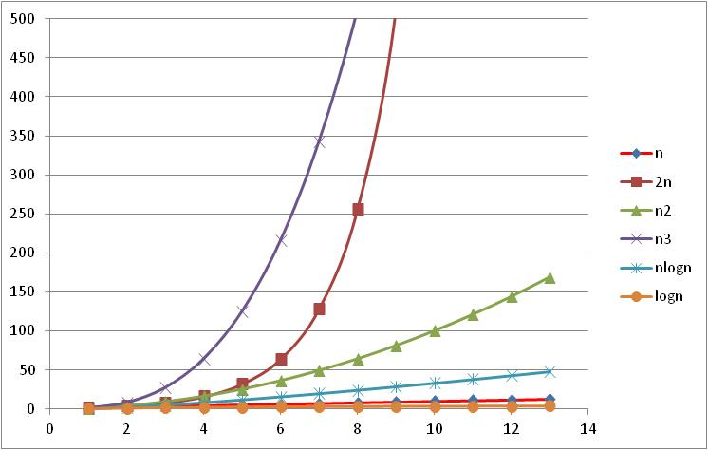
Types of Algorithms
n³
2^{n}
n²
n log n
n
log n

Slide 12
Asymptotic Notations
Asymptotic means the study of functions of a parameter n, as n grows larger and larger without bound
What is Constant c ?
Worst-Case
Best-Case
Average-Case Efficiencies
n | 2n+20 | n²
1 | 22 | 1
2 | 24 | 4
3 | 26 | 9
4 | 28 | 16
5 | 30 | 25
6 | 32 | 36
7 | 34 | 49
8 | 36 | 64
9 | 38 | 81
10 | 40 | 100

Slide 13
Big Oh (O) Notation
f(n) = O(g(n)) (read as “f of n is equal to the big Oh of g of n”) such that there exists two positive constants c and n₀ with the constraint that |f(n)| ≤ c |g(n)| for all n ≥ n₀.
c g(n)
f(n)
n₀

Slide 14
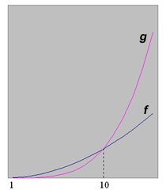
Simple Example
n | f(n) | g(n)
10 | 10,000 | 10,000
50 | 250,000 | 6,250,000
100 | 1,000,000 | 100,000,000
150 | 2,250,000 | 506,250,000
f(n) = 100 n², g(n) = n⁴

Slide 15
Omega Notation (Ω)
f(n) = Ω(g(n)) (read as “f of n is equal to omega of g of n”) iff there exists positive constants c and n₀ such that for all n > n_{o}, |f(n)| ≥ c |g(n)|.
f(n)
c g(n)
n₀

Slide 16
Theta Notation (Θ)
f(n) = Θ(g(n)) iff there exist positive constants c₁ and c₂ such that for all n>n₀, c₁ |g(n)| ≤ |f (n)| ≤ c₂ |g(n)|.
c₂ g(n)
f(n)
c₁ g(n)
n₀

Slide 17
Computing Efficiency (O )
Example-1
Given f(n) = 3n + 2, find g(n)
Solution
3n + 2 ≤ 3n + n for n ≥ 2
3n + 2 ≤ 4n
and so c = 4, and n₀ = 2
Verify:
n f(n) ≤ cg(n)
2 8 ≤ 8 √
3 11 ≤ 12 √
4 14 ≤ 16 √

Slide 18
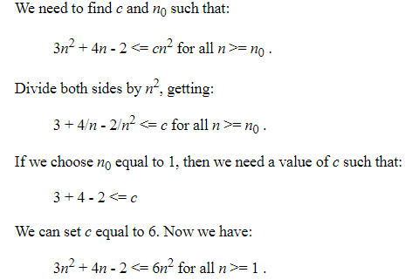
Example-2
f(n) = 3n² + 4n - 2 = O(n²),
find g(n)
Solution

Slide 19
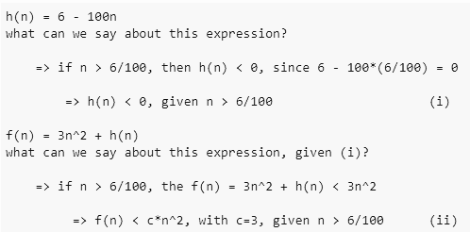
Example-3
Prove that: 3n² − 100n + 6 = O(n²)
f(n) = 3n² + h(n)
Where, h(n) = 6 - 100n

Slide 20
Example-3
f(n) = 5n³ + n² + 6n + 2 , find g(n)
Solution
5n³ + n² + 6n + 2 ≤ 5n³ + n² + 6n + n for n ≥ 2
≤ 5n³ + n² + 7n
5n³ + n² + 7n ≤ 5n³ + n² + n² for n² ≥ 7n
5n³ + 2n² ≤ 5n³ + n³ for n³ ≥ 2n²
≤ 6n³
and so c = 6, and n₀ = 7
Verify:
n f(n) ≤ cg(n)
2 18 ≤ 24 √
3 37 ≤ 54 √
4 62 ≤ 96 √

Slide 21
Example-4
f(n) = 4n³ + 2n + 3 , find g(n)
Solution
4n³ + 2n + 3 ≤ 4n³ + 2n + n for n ≥ 3
≤ 4n³ + 3n
4n³ + 3n ≤ 4n³ + n³ for n³ ≥ 3n (n² ≥ 3)
≤ 5n³
and so c = 5, and n₀ = 3
Verify:
n f(n) ≤ cg(n)
3 117 ≤ 135 √
4 203 ≤ 240 √

Slide 22
Example-5
Given f(n) = 2^{n} + 6n² + 3n, prove that f(n) = O(2^{n})
Solution
2^{n} + 6n² + 3n ≤ 2^{n} + 6n² + n² for n² ≥ 3n (n ≥ 3)
≤ 2^{n} + 7n²
2^{n} + 7n² ≤ 2^{n} + 7 2^{n} for 2^{n} ≥ n²
≤ 8 2^{n}
c = 8 and n₀ = 4 (n = 3 won’t satisfy the inequality)
Verify:
n f(n) ≤ cg(n)
3 71 ≤ 64 ×
4 124 ≤ 128 √

Slide 23
Example-6
Show n³ ≠ O(n²)
Solution
n³ = O(n²)
n³ ≤ c n² for all n ≥ n₀
n ≤ c for all n ≥ n₀
c can not be greater than n.

Slide 24
Example-7
f(n) = 19 n ≤ c n³
Dividing by n³ on either side, we have
19/n² ≤ c
With n₀ = 1, c must be 19.

Slide 25
Comparison
Better algorithm!
O(n²)
O(log n)
TIE O(n)
O(n⁵)
O(n¹⁵)
O(n⁶)
Function #1
n³ + 2n²
n^{0.1}
n + 100n^{0.1}
5n⁵
n⁻¹⁵2^{n}/100
8^{2log n}
Function #2
100n² + 1000
log n
2n + 10 log n
n!
1000n¹⁵
3n⁷ + 7n

Slide 26
Big-Omega - Example
f(n) = 19 n ≤ c n³
Dividing by n³ on either side, we have
19/n² ≤ c
With n₀ = 1, c must be 19.

Slide 27
Big-Omega Example
f(n) = n^{1/2} = Ω( log n)
using the definition c g(n) ≤ f(n)
c log n ≤ n^{1/2}
for n = 16, c log 2⁴ ≤ 16^{1/2}
c 4 ≤ 4
So, c = 1 and n₀ = 16
Exercise: (i) Prove that n ≠ Ω (n²)

Slide 28
Computing Θ
Prove that – 3n = Θ(n²)
Solution
Find c₁:
c₁ n² ≤ – 3n for all n ≥ n₀
c₁ ≤ –
c₁ ≤ – let n = 7
Hence, c₁ = , n₀ = 7

Slide 29
Computing Θ...
Find c₂:
c₂ ≥ –
for large n,
c₂ ≥ - 0
Hence, c1 = , c₂ = , n₀ = 7
Verify:
n = 7,
3.5 ≤ 3.5 ≤ 24.5
n = 8,
4.5 ≤ 8 ≤ 32

Slide 30
Limit Theory
We can define the asymptotic notations O, Ω, Θ using limit theory
O
Ω
Θ
= c for some 0 ≤ c < ∞
= c for some 0 < c ≤ ∞
= c for some 0 < c < ∞

Slide 31
Efficiency of Iterative Algorithms
Example - 1
Algorithm MinElement(A[1..n])
// Input: Array A of n elements
// Output: returns minimum element
min ← A[1]
for i ←2 to n do
if A[i] < min
min ← A[i]
return min
end MinElement

Slide 32
Efficiency
f(n)
= (n – 1)
= O(n)

Slide 33
Example - 2
Algorithm ElementUniqueness(A[1..n])
// Input: Array A of n elements
// Output: true when all elements are distinct, else false
for i ←1 to n – 1 do
for j ← i + 1 to n do
if A[i] = A[j]
return false
return true
end ElementUniqueness.

Slide 34
Analysis
C_{WC}(n)

Slide 35
Exercise
Remove all duplicates in a given list.

Slide 36
Analyzing Recursive Algorithms
Backward Substitution Method
Recursive Tree Method
Master Theorem

Slide 37
Backward Substitution Method
Sum of n natural numbers
S(n) = S(n – 1) + n for n > 0
S(0) = 0 for n = 0
Solution:
S(n) = S(n – 1) + n
Substituting (n – 1) for n, we get
S(n) = S(n – 2) + (n – 1) + n
Substituting (n – 2) for n in the original equation,
S(n) = S(n – 3) + (n – 2) +(n – 1) + n
S(n) = S(n – i) + (n – i + 1) + ….. + n ith term
S(n) = S(n – n) + (n – n + 1) +….. + n nth term
S(n) = S(0) + 1 + 2….. + n =

Slide 38
Factorial
■ Algorithm Fact(n)
// Input: A positive integer, n
// Output: Factorial of n
if n = 0
return 1
else
return n × Fact(n – 1)
end Fact.

Slide 39
Analysis
M(n) = M(n – 1) + 1
M(n) = [M(n – 2) + 1] + 1 = M(n – 2) + 2
M(n) = [M(n – 3) + 1] + 2 = M(n – 3) + 3
Collecting the terms, we get
= M(n – 1) + 1
= M(n – 2) + 2
= M(n – 3) + 3
= ……………
= M(n – n) + n
= M(0) + n
= n

Slide 40
Recursive Tree
Write the recursive tree: root and branches
Write the Level #
Write the # of nodes in each level
Write the Level sum
Add all the level sums
Simplify the equation

Slide 41
Example-1
T(1) =1, n = 1
T(n) =T(n-1) + n n > 1
n
n-1
n-2
...
2
1

Slide 42
Example-2
T(1) =1, n = 1
T(n) = 2T(n-1) + n n > 1
Level# # of nodes
0 1
1 2
2 4
i 2^{i}
n-1
n
n-1 n-1
n-2 n-2 n-2 n-2
..............
1 1 1 1

Slide 43
Example-3
T(1) =1 n = 1
T(n) = 2T(n/2) + n n > 1
L# | #N |  |  |  |  |  |  |  |  |  |  |  |  |  | Level sum
0 | 1 | ... | ... | .. | ... | ... |  | n |  |  | ... | ... | ... | .... | 1.n
1 | 2 | ... | ... | n/2 |  |  |  |  |  |  | n/2 |  | ... | .... | 2(n/2) = n
2 | 2² | ... | n/4 |  |  | n/4 |  |  |  | n/4 |  |  | n/4 | ... | 4(n/4) = n
3 | 2³ | n/8 |  | n/8 | n/8 |  | n/8 |  | n/8 |  | n/8 | n/8 |  | n/8 | 8(n/8) = n
.. | ... |  |  |  |  |  |  |  |  |  |  |  |  |  | ...
i | 2^{i}
h-1 | 2^{h-1}
h | 2^{h} | T(1) | T(1) | T(1) | T(1) | T(1) | T(1) | T(1) | T(1) | T(1) | T(1) | T(1) | T(1) | T(1)

Slide 44
Example-3...

Slide 45
Example-4
T(1) =1 n = 1
T(n) = 4T(n/2) + n n > 1
L# | #N |  |  |  |  |  |  |  |  |  |  |  |  |  | Level sum
0 | 1 | ... | ... | .. | ... | ... |  | n |  |  | ... | ... | ... | .... | 1.n
1 | 4 | ... | ... | n/2 |  |  | n/2 |  |  | n/2 |  |  | n/2 | .... | 4(n/2) = 2n
2 | 4² | n/4 | n/4 | n/4 | n/4 | .... | .... | .... | .... | ..... | n/4 | n/4 | n/4 | n/4 | 4²(n/4) = 4n
3 | 4³ |  |  |  |  |  |  |  |  |  |  |  |  |  | 4³(n/8) = 8n
.. | ... |  |  |  |  |  |  |  |  |  |  |  |  |  | ...
i | 4^{i} |  | ..... | ..... | .... | .... | ..... | ..... | ..... | ..... | ..... | ..... | ..... |  | 4^{i}(n/2^{i}) = 2^{i}n
h-1 | 4^{h-1}
h | 4^{h} | T(1) | T(1) | T(1) | T(1) | T(1) | T(1) | T(1) | T(1) | T(1) | T(1) | T(1) | T(1) | T(1) | 4^{h} T(1)

Slide 46
Example-4...
incremental geometric series

Slide 47
Example-5
T(1) =1 n = 1
T(n) = 3T(n/3) + n² n > 1

Slide 48
Master Theorem
where, n₀ ≥ 1, b > 1, k = 0, 1, 2, ... are constants.
Example:
e = log_{b}(a) = log₂(2) = 1
Therefore, k = e = 1 satisfies (II) of the Master Theorem,
Hence, T(n) ∈ Θ(n log n)

Slide 49


